Slide 1

UNIX SHELL PROGRAMMING
INTRODUCTION
PREETHI.P
Department of Computer Science and
Engineering

Slide 2

UNIX SHELL PROGRAMMING
COURSE INTRODUCTION
PREETHI.P
Department of Computer Science and Engineering

Slide 3
UNIX SHELL PROGRAMMING
INTRODUCTION TO UNIX
UNIX
Unix is an operating system
A set of programs that acts as a link between the computer and user.
History:
Developed in 1969 by a group of AT & T Employees
Linux, Solaris Unix, AIX, HP Unix and BSD are few flavours of Unix.
Multiuser system and Multitasking Environment

Slide 4
UNIX SHELL PROGRAMMING
INTRODUCTION TO SHELL
SHELL
A Shell provides you with an interface to the Unix operating system.
It gathers input from user and executes programs based on that input.
Shell is an environment in which we can run our commands, programs, and shell scripts.

Slide 5
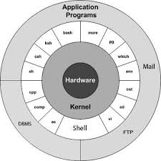
UNIX SHELL PROGRAMMING
INTRODUCTION TO UNIX
Image reference: tutorialspoint.com

Slide 6
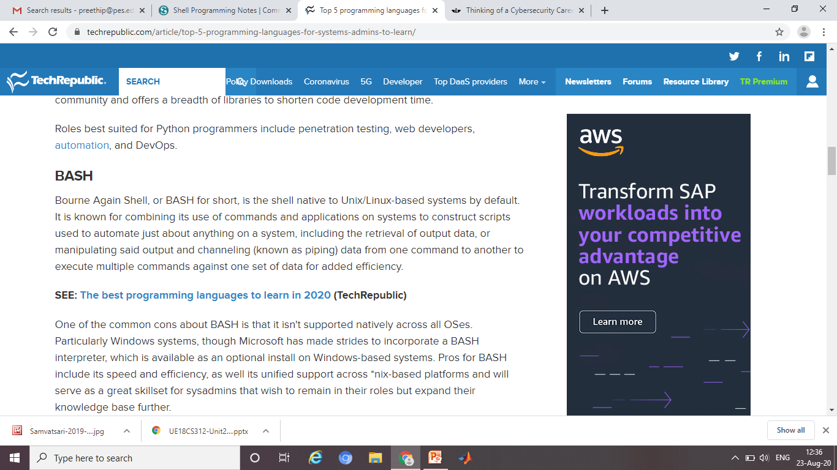
UNIX SHELL PROGRAMMING
INTRODUCTION

Slide 7
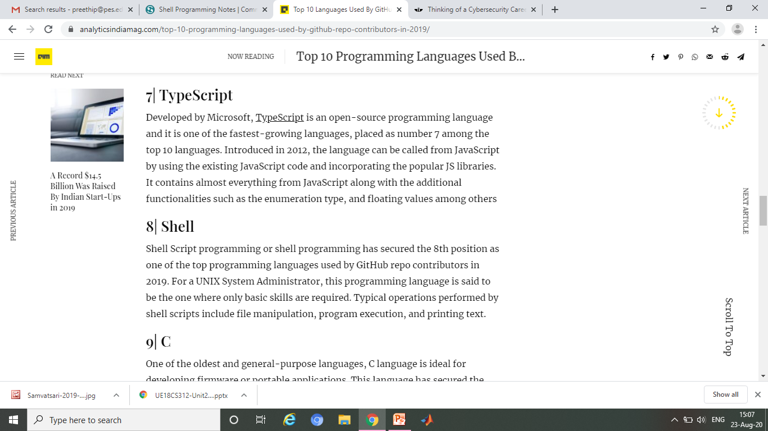
UNIX SHELL PROGRAMMING
INTRODUCTION

Slide 8
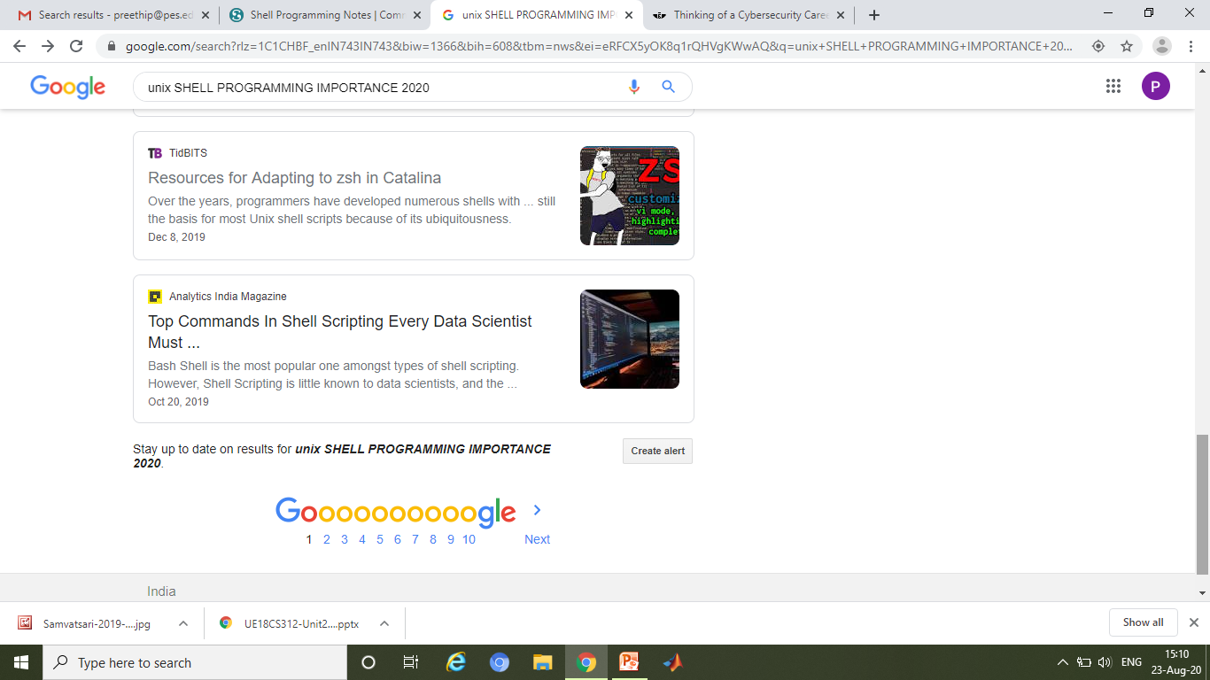
UNIX SHELL PROGRAMMING
INTRODUCTION

Slide 9
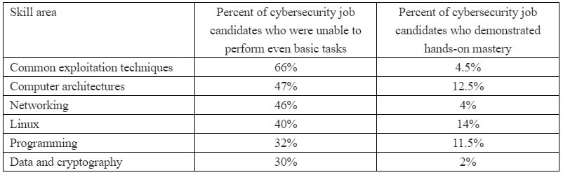
UNIX SHELL PROGRAMMING
INTRODUCTION
Table reference: kerbsonsecurity.com

Slide 10
UNIX SHELL PROGRAMMING
ADVANTAGES
ADVANTAGES OF SHELL SCRIPTING
Quicker than Programming in any languages
To automate frequently performed task
Easy to use and understand
Non geeks can also modify the scripts
Easy to work with files and String processing
Great for prototyping, No compilation

Slide 11
UNIX SHELL PROGRAMMING
Features of Shell
Shells are CaSe SeNsItIvE
It allows Interaction with the Kernel
You can create functions and pass arguments
MAN Page

Slide 12
UNIX SHELL PROGRAMMING
Shell in use
Shell Types:
Bourne shell ( sh)
Korn shell ( ksh)
Bourne Again shell ( bash)
POSIX shell ( sh)
C Shell (csh)
csh and ksh are recommended for command line usage
sh and bash are recommended for writing scripts

Slide 13
THANK YOU
PREETHI.P
Assistant Professor , Department of Computer Science
preethip@pes.edu

